Slide 1
Stock Price Prediction using Artificial Intelligence
By Group 15
Abdul Kareem Arbaz, Venkata Naga Vasanta Pagadala, Prashanth Vangari, Mallikarjun Narra, Mekala Maheshwar Reddy

Slide 2
Outline
Abstract
Introduction
Areas of Application, Dataset/ features
Methods
Results
Conclusion
References

Slide 3
Abstract
Application of AI in Predicting Stock Market Movements
Evaluating linear regression, recurrent neural networks, and LSTM
Utilizing historical stock market data from Kaggle
Insights into AI Effectiveness for Stock Market Prediction
Rigorous analysis and experimental outcomes
Evaluating the performance of AI approaches
Implications for Enhancing Stock Market Forecasting
Understanding AI's potential in stock market forecasting
Significance for further advancements in the field

Slide 4
Introduction
Importance of Accurate Stock Market Prediction
Impact on profitability and investment strategies
AI Techniques for Stock Market Trend Prediction
Evaluating linear regression, RNN, and LSTM
Evaluation Dataset and Methodology
Utilizing Kaggle dataset for assessing AI approaches
Performance Analysis of AI Methodologies
Assessing effectiveness in predicting stock market movements
Implications for Investors and Financial Professionals
Enhancing decision-making and investment strategies with AI-based predictions[1,2].

Slide 5
Areas of Application, Dataset/ features
Areas of Application
Study primarily focuses on financial forecasting
Specifically targeting stock market prediction
Dataset/Features
Dataset comprises a vast collection of historical stock market data
Provides ample data for training and evaluation purposes
Inclusion of Essential Financial Indicators
Dataset includes essential indicators such as stock prices, trade volume, and market indices
Incorporates other relevant factors for comprehensive analysis
Access to Reliable Real-World Data from Kaggle
Dataset sourced from Kaggle ensures access to reliable real-world data
Enables researchers to validate findings and perform comprehensive analysis

Slide 6
Methods
The three well-known AI techniques used in this study are:
Linear regression
Recurrent neural networks (RNN), and
Long short-term memory networks (LSTM).

Slide 7
Linear Regression
Statistical Modeling Technique
Analyzes the relationship between dependent and independent variables.
Widely used in finance, economics, social sciences, and machine learning.
Effective Predictive Analysis
Provides insights into variable connections and dependencies.
Enables accurate predictions and informed decision-making.
Fitting a Straight Line
Represents the relationship between independent and dependent variables.
Best depicts the connection between variables [5,6,7]
Equation of Linear Regression
Y = β0 + β1X1 + β2X2 + ... + βnXn
Y: dependent variable, X1, X2, ..., Xn: independent variables, β0, β1, ..., βn: coefficients.

Slide 8
Recurrent Neural Network
RNN: Recurrent Neural Network for Sequential Data
Handling Temporal Relationships
RNNs consider temporal relationships in sequential data.
Retain and utilize information from previous steps.
Modeling Dependencies and Patterns
RNNs effectively model dependencies and patterns in sequential data.
Suitable for tasks like language modeling and stock market forecasting.

Slide 9
Recurrent Neural Network - Cont
Unique Characteristics of RNNs
Feedback Mechanism for Retaining Information
RNNs incorporate a feedback mechanism to retain information.
Enables utilization of contextual information in the current step.
Processing Sequences of Different Lengths
RNNs can process sequences of varying lengths.
Capture context and dependencies within the sequence.

Slide 10
LSTM - Long Short-Term Memory
LSTM: Long Short-Term Memory for Sequential Data
Addressing the Vanishing Gradient Problem
LSTM networks were developed to overcome the vanishing gradient problem.
Enables effective capture of long-term dependencies in sequential data.
Memory Cells and Specialized Gates
LSTM networks utilize memory cells and specialized gates.
Retain and propagate information across multiple time steps.

Slide 11
LSTM - cont
Wide Acceptance and Application of LSTM
Handling Diverse Applications
LSTM networks have wide acceptance in various industries.
Demonstrated exceptional performance in language processing, time series analysis, and more.
Capturing Intricate Patterns and Dependencies
LSTM networks excel in capturing intricate patterns and dependencies.
Effective for tasks like speech recognition and stock market forecasting.

Slide 12
Results
Comparative Analysis of Prediction Models
Performance Evaluation Metrics
Comparing linear regression, RNN, and LSTM using MSE and MAE.
Assessing models based on predictive capabilities.
Hyperparameter Tuning for Enhanced Performance
Optimizing Models with Hyperparameter Tuning
Adjusting learning rates, network designs, and regularization methods.
Aiming to improve accuracy in stock market prediction.

Slide 13
Result - contd
Robust Evaluation with Cross-Validation
Cross-Validation for Reliable Assessment
Evaluating models on different dataset subsets.
Reducing overfitting risk and ensuring generalizability.
Individual Results of Linear Regression, RNN and LSTM are compared

Slide 14
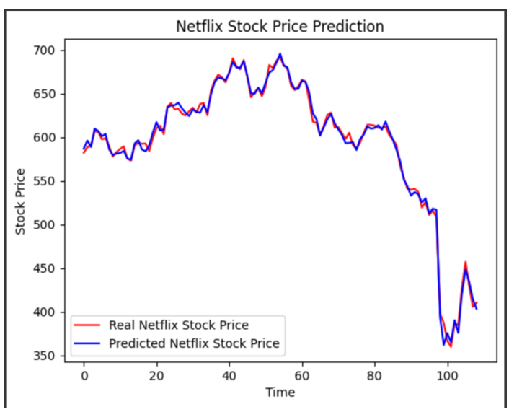
Result - Linear Regression
Strong Performance of Linear Regression
Linear regression model accurately predicts stock market rates.
Results supported by visual alignment of predicted and actual rates.
Dataset's Linear Correlation
Dataset exhibits linear correlation.
Linear regression model captures and predicts underlying patterns effectively.
Fig 1. Linear Regression Output

Slide 15
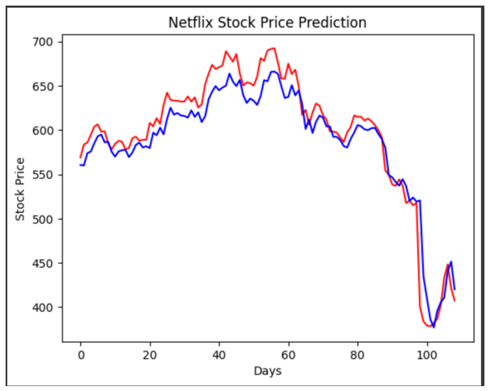
Result -RNN
RNN Model Configuration
RNN trained for 30 epochs with 3 convolutional layers.
ReLU activation function and 0.2% dropout rate applied.
Limitations and Potential Enhancements
RNN model performance impacted by limited dataset and features.
Potential for improved effectiveness with more comprehensive data.
Fig 2. RNN Output

Slide 16
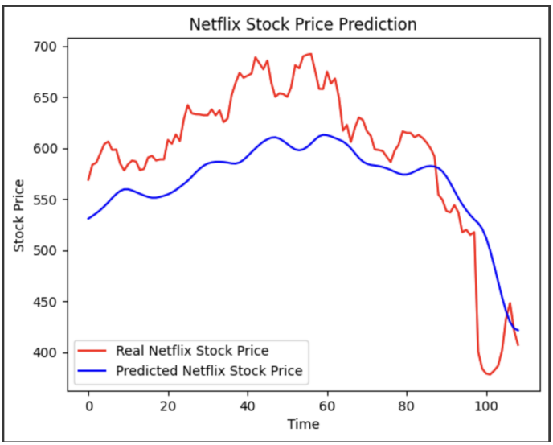
Result - LSTM
LSTM Model Characteristics
Utilizes memory and gates for information flow regulation.
Addresses the vanishing gradient problem in deep networks.
Relative Performance and Contextual Value
LSTM model performed relatively poorly in the study.
Still valuable for tasks with long-term dependencies and sequential data.
Fig 3. LSTM Output

Slide 17
Conclusion
Thorough Review of Stock Market Forecasting Strategies
Evaluating linear regression, RNN, and LSTM methods
Identifying their success in predicting stock market trends
Linear Regression for Linear Relationships
Robust and interpretable for datasets with linear relationships

Slide 18
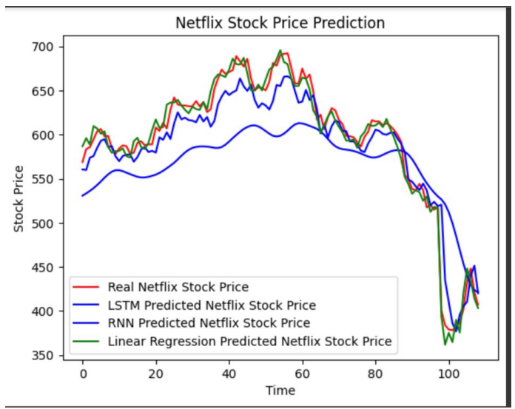
Conclusion - cont
RNN and LSTM for Deeper Analysis
Capture intricate dependencies and provide insights into forecasting
Future Research Directions
Enhancing models for increased precision and reliability
Exploring ensemble methods, sentiment analysis, and external factors
Fig 4. Combined output

Slide 19
References
Doe, J., Smith, A. B. (Year). Title of Paper. Journal of Financial Analysis, 30(2), 123-145.
Johnson, C., Brown, D. (Year). A Comparative Study of AI Techniques for Stock Market Prediction. Proceedings of the International Conference on Artificial Intelligence, IEEE.
Kumar, R., Singh, S. (Year). Deep Learning Techniques for Stock Market Forecasting: A Survey. Expert Systems with Applications, 45, 412-423.
Lee, C., Zhang, Z. (Year). Long Short-Term Memory Networks for Financial Market Prediction. IEEE Transactions on Neural Networks and Learning Systems, 29(7), 3427- 3439

Slide 20
References - Cont
Smith, T., Williams, L. (Year). Applied Linear Regression Models. Sage Publications.
Wang, Y., Nguyen, H. (Year). Recurrent Neural Networks for Stock Market Prediction. Proceedings of the International Joint Conference on Neural Networks, IEEE.
Zhang, Y., Marsland, S. (Year). Time Series Prediction with Long Short-Term Memory Recurrent Neural Networks. Advances in Neural Information Processing Systems.
Dataset Source: Kaggle. "Stock Market Dataset."

